Slide 1
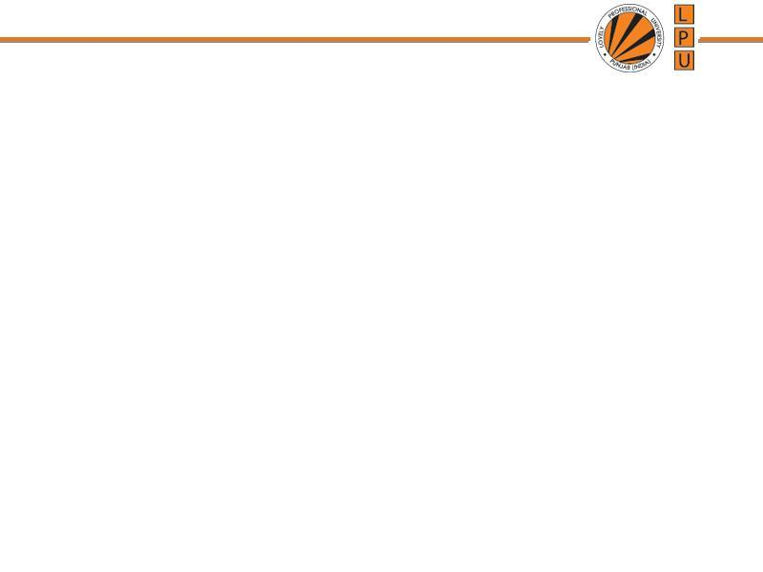
Chapter: CPU/ Process Scheduling

Slide 2
Basic Concept
CPU Scheduling is basis of Multi-programmed OS
Objective of Multi-programming is to have some processes running all the time to maximize CPU Utilization.

Slide 3
Sequence of CPU and I/O Bursts
CPU Burst- when process is executed in CPU
CPU Burst Time: The amount of time the process uses the processor
Types of CPU bursts:
  Long bursts -- process is CPU bound (spend max. time with CPU
  Short bursts -- process is I/O bound (spend max. time with I/O)
I/O Burst- when CPU is waiting for I/O completion for further execution.

Slide 4

Sequence of CPU and I/O Bursts

Slide 5
CPU Scheduling Decisions
When process switches from Running State to Waiting State (i/o request or wait)
When process switches from Running to Ready State (interrupt)
When process switches from Waiting State to Ready State (at completion of i/o)
When a process terminates
1. Non-preemptive
2. Pre-emptive
3. Pre-emptive
4. Non-Preemptive (allow)

Slide 6

Process States

Slide 7
Scheduling
Non-Preemptive
Preemptive

Slide 8
Non-Preemptive or Cooperative Scheduling
Once the CPU is allocated to a process, process keeps the CPU until:
  it releases when it completes
  by switching to waiting state
  E.g : 1. Windows 3.x and Apple Macintosh operating systems uses non-preemptive scheduling
  2. Windows (also 10) uses a round-robin technique with a multi-level feedback queue for priority scheduling
Process is executed till completion. It cannot be interrupted.
Eg First In First Out

Slide 10
Preemptive Scheduling
The running process is interrupted for some time and resumed later on, when the priority task has finished its execution.
CPU /resources is/are taken away from the process when some high priority process needs execution.

Slide 11
Dispatcher
A module that gives control of CPU to the process selected by short-term scheduler.
Functions:
  Switching Context
  Switching to User mode
  Jumping to proper location to restart the program.
The dispatcher should be as fast as possible, given that it is invoked during every process switch
Dispatch Latency:
  Time taken for the dispatcher to stop one process and start another running.

Slide 12
Scheduling Criteria
Which algorithm to use in a particular situation
1. CPU Utilization: CPU should be busy to the fullest
2. Throughput: No. of processes completed per unit of time.
Turnaround Time: The time interval from submitting a process to the time of completion.
Turnaround Time= Time spent to get into memory + waiting in ready queue + doing I/O + executing on CPU
(It is the amount of time taken to execute a particular process)

Slide 13
Scheduling Criteria
4. Waiting Time: Time a process spends in ready queue.
Amount of time a process has been waiting in the ready queue to acquire control on the CPU.
5. Response Time: Time from the submission of a request to the first response, Not Output
6. Load Average: It is the average number of processes residing in the ready queue waiting for their turn to get into the CPU.

Slide 14
Scheduling Algorithm Optimization Criteria
Max CPU utilization
Max throughput
Min turnaround time
Min waiting time
Min response time

Slide 15
First-Come, First-Served (FCFS)
Processes that request CPU first, are allocated the CPU first
FCFS is implemented with FIFO queue.
A process is allocated the CPU according to their arrival times.
When process enters the ready queue, its PCB is attached to the Tail of queue, When CPU is free, it is allocated to the process selected from Head/Front of queue.

Slide 16
First-Come, First-Served (FCFS)
“Run until Completed:” FIFO algorithm
Example: Three processes arrive in order P1, P2, P3.
  P1 burst time: 24
  P2 burst time: 3
  P3 burst time: 3
Draw the Gantt Chart and compute Average Waiting Time and Average Turn Around Time/Completion Time.
Sol: As arrival time is not given assume order of arrival as: P1,P2,P3

Slide 18
First-Come, First-Served (FCFS)
Example: Three processes arrive in order P1, P2, P3.
  P1 burst time: 24
  P2 burst time: 3
  P3 burst time: 3
Waiting Time
  P1: 0
  P2: 24
  P3: 27
Turnaround Time/Completion Time:
  P1: 24
  P2: 27
  P3: 30
Average Waiting Time: (0+24+27)/3 = (51/3)= 17 milliseconds
Average Completion Time: (24+27+30)/3 = 81/3=27 milliseconds
P1
P2
P3
0
24
27
30

Slide 19
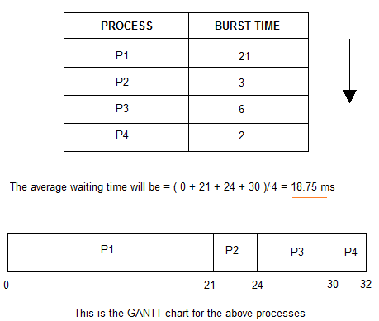
H.W.: Example: First-Come, First-Served (FCFS)

Slide 20
First Come First Serve
Process id | A T | BT | CT | TAT | WT
1 | 0 | 2
2 | 3 | 1
3 | 5 | 6
Turn around time= Completion Time- Arrival Time
Waiting Time= Turn around Time-Burst Time

Slide 21
First Come First Serve
Process id | A T | BT | CT | TAT | WT
1 | 0 | 2
2 | 3 | 1
3 | 5 | 6

Slide 22
First Come First Serve (Convoy Effect
Solve: FCFS Arrival Time
Process | A T | BT | CT | TAT | WT
P1 | 0 | 4
P2 | 1 | 3
P3 | 2 | 1
P4 | 3 | 2
P5 | 4 | 5
Turn around time= Completion Time- Arrival Time
Waiting Time= Turn around Time-Burst Time

Slide 23
Shortest Job First
Processes with least execution time are selected first.
CPU is assigned to process with less CPU burst time.
SJF:
  Non-Preemption: CPU is always allocated to the process with least burst time and Process Keeps CPU with it until it is completed.
  Pre-Emption: When a new process enters the queue, scheduler checks its execution time and compare with the already running process.
  If Execution time of running process is more, CPU is taken from it and given to new process.

Slide 24
Shortest Job First(Preemptive)
Q1. Consider foll. Processes with A.T and B.T
Process A.T B.T
P1 0 9
P2 1 4
P3 2 9
Cal. Completion time, turn around time and avg. waiting time.
SJF(Pre-emptive)-> SRTF

Slide 25
Shortest Job First(Preemptive)
Process A.T B.T
P1 0 9
P2 1 4
P3 2 9

Slide 26
Shortest Job First(Preemptive)
Q1. Consider foll. Processes with A.T and B.T
Process A.T B.T
P1 0 5
P2 1 3
P3 2 3
P4 3 1
Cal. Completion time, turn around time and avg. waiting time.

Slide 27
Shortest Job First(Preemptive)
Process A.T B.T
P1 0 5
P2 1 3
P3 2 3
P4 3 1

Slide 28
H.W: Shortest Job First(Non-Preemptive)
Q1. Consider foll. Processes with A.T and B.T
Process A.T B.T
P1 1 7
P2 2 5
P3 3 1
P4 4 2
P5 5 8
Cal. Completion time, turn around time and avg. waiting time.

Slide 29
H.W: Shortest Job First(Non-Preemptive)
Process A.T B.T
P1 1 7
P2 2 5
P3 3 1
P4 4 2
P5 5 8

Slide 30
H.W: Practice: Shortest Job First (Non Preemption)
  P1 burst time: 15
  P2 burst time: 8
  P3 burst time: 10
  P4 burst time: 3

Slide 31
H.W: Practice: Shortest Job First (Preemption)
Process | Arrival Time | Burst Time | CT | Turn around time | Waiting Time
P1 | 0 | 8
P2 | 1 | 4
P3 | 2 | 9
P4 | 3 | 5
Turn around time= Completion Time- Arrival Time
Waiting Time= Turn around Time-Burst Time

Slide 32
Practice: Shortest Job First (Preemption)
Process | Arrival Time | Burst Time | CT | Turn around time | Waiting Time
P1 | 0 | 7 | 16
P2 | 2 | 4 | 7
P3 | 4 | 1 | 5
P4 | 5 | 4 | 11
Turn around time= Completion Time- Arrival Time
Waiting Time= Turn around Time-Burst Time

Slide 33
Practice: Shortest Job First (Preemption)
Process | Arrival Time | Burst Time | CT | Turn around time | Waiting Time
P1 | 0 | 7 | 16
P2 | 2 | 4 | 7
P3 | 4 | 1 | 5
P4 | 5 | 4 | 11

